Slide 1
How to Navigate the Intertek Building Products Directory
Step-by-Step Guide to Finding Certified Products & Compliance Documentation
Charlie Meyers – Senior Manager, Product Certification and Industry Associations
2.18.2026

Slide 2

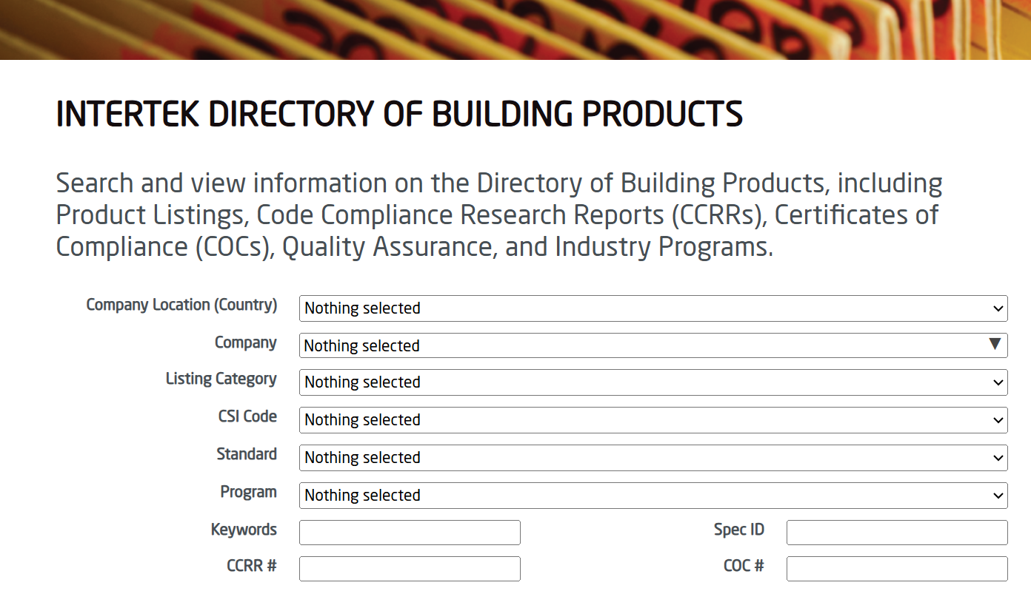
What is the Directory?
Online searchable database of products that participate in Intertek’s Building & Construction Product Certification Program
Used by end users, Authorities Having Jurisdiction (AHJs), etc. to validate participation in program
Provides supporting documentation for listings, such as Code Compliance Research Reports (CCRRs) and Design Listings

Slide 3
Search Page Overview
01
Company
06
CCRR Number
02
Listing Category
07
Design Document/Listing
03
Standard
08
Trade/Brand Name
04
Keyword
05
SpecID (Number issued by Intertek)

Slide 4
Best Search Methods
01
02
03
04
05
Start Broad
Select Company
Simple Keywords
Reset after search
Refine if needed

Slide 5

Live Example #1
Searching by Company Name

Slide 6

Live Walkthrough #2
Keyword Only Search

Slide 7
How to Review a Listing
01
Confirm Company
06
Download CCRR and/or Design Listing
02
Review Listing Information
03
Check Applicable Standards
04
Verify scope of Certification
05
Generate Listing Report

Slide 8
Q & A

Slide 9
Design Listing Nomenclature
AAA/BBB-CCC-DD
AAA = Manufacturer identifier by initials
BBB = System type derived from CSI Code
CCC = Rating duration in minutes
DD = Sequence number for multiple design listings of the same manufacturer, system type, and rating duration.
Example design listing ABC/BPF 120-01:
Represents a listing for the fictional “A Basic Company’s” Building Perimeter Firestop system (referenced with CSI code 07 84 53 Building Perimeter Firestopping) with a rating period of 120 minutes and it represents the first listing for this rating period under this manufacturer and CSI Category.

Slide 10
Common csi masterformat abbreviations: duct related systems
08 31 00 Access Doors and Panels
23 00 00 Heating, Ventilating, and Air Conditioning (HVAC)
23 35 00 Special Exhaust Systems
23 35 33 Listed Kitchen Ventilation Exhaust System
System Abbreviations Include:
DI | Duct Insulation
Legacy Abbreviations Include:
FRD | Grease Duct Protection
CFD xxx F | Chemical Fume Duct
GD xxx F | Grease Duct Protection
PP xxx P | Plenum Protection System
VAD xxx F | Ventilation Duct Protection
O5 50 00 Metal Fabrications
05 58 00 Formed Metal Fabrications
System Abbreviations Include:
FMF | Formed Metal Fabrications

Slide 11
Common csi masterformat abbreviations: firestop and joint systems
07 84 00 Firestopping
System Abbreviations Include:
PF | Penetration Firestopping
PFM | Penetration Firestopping Mortars
PFD | Penetration Firestopping Devices
JF | Joint Firestopping
BPF | Building Perimeter Firestopping
Legacy Abbreviations Include:
PH | Penetrant Horizontal
PHV | Penetrant Horizontal & Vertical
PV | Penetrant Vertical
JS | Joint Sealants
PFB | Perimeter Fire Barrier
BP | Building Perimeter
FS xxx F | Firestopping, Floor
FS xxx W | Firestopping, Wall
CEJ xxx P | Construction/Expansion Joint, Perimeter
07 95 00 Expansion Control
System Abbreviations Include:
EC | Expansion Control
EJCA | Expansion Joint Cover Assemblies
Legacy Abbreviations Include:
EJH | Expansion Joint, Horizontal
EJV | Expansion Joint, Vertical

Slide 12
Common csi masterformat abbreviations: protection systems
07 00 00 Thermal and Moisture Protection
07 20 00 Thermal Protection
07 21 00 Thermal Insulation
System Abbreviations Include:
BI | Blanket Insulation
FBI | Foam Board Insulation
FBI | Fibrous Board Insulation
MBI | Mineral Board Insulation
MFF | Mineral-Fiber Fireproofing
07 80 00 Fire and Smoke Protection
07 81 00 Applied Fireproofing
System Abbreviations Include:
AF | Applied Fireproofing
CF | Cementitious Fireproofing
IF | Intumescent Fireproofing

